Slide 1
Single Case Studies and Process Tracing
Doing Political Research

Slide 2
Single Case Studies
What is a case?
Same as last week: An instance of a political system, event or phenomenon in a specified place and/or at a certain time
We need to know the universe of cases
Why use single case studies?
Focus on a particular causal process
Helps us to generate theory
Anomalous cases can be vital eg Lijphart’s 1968 study of democracy in the Netherlands

Slide 3
Classifying Types of Evidence (Van Evera)
Certitude: the likelihood that the evidence will be there if the hypothesis is true
Uniqueness: the likelihood that the evidence will be there if the hypothesis is not true

Slide 4
Problems with Single Case Studies
Generalisability
Requires good existing concepts and background knowledge
Difficulty finding evidence, which is often partial and biased

Slide 5
Styles of Single Case Study Research
Interpretative thick description
Rational choice analytic narratives
Process tracing
focus on causal mechanisms and processes
connecting variables and events
testing hypotheses based on causal mechanisms

Slide 7
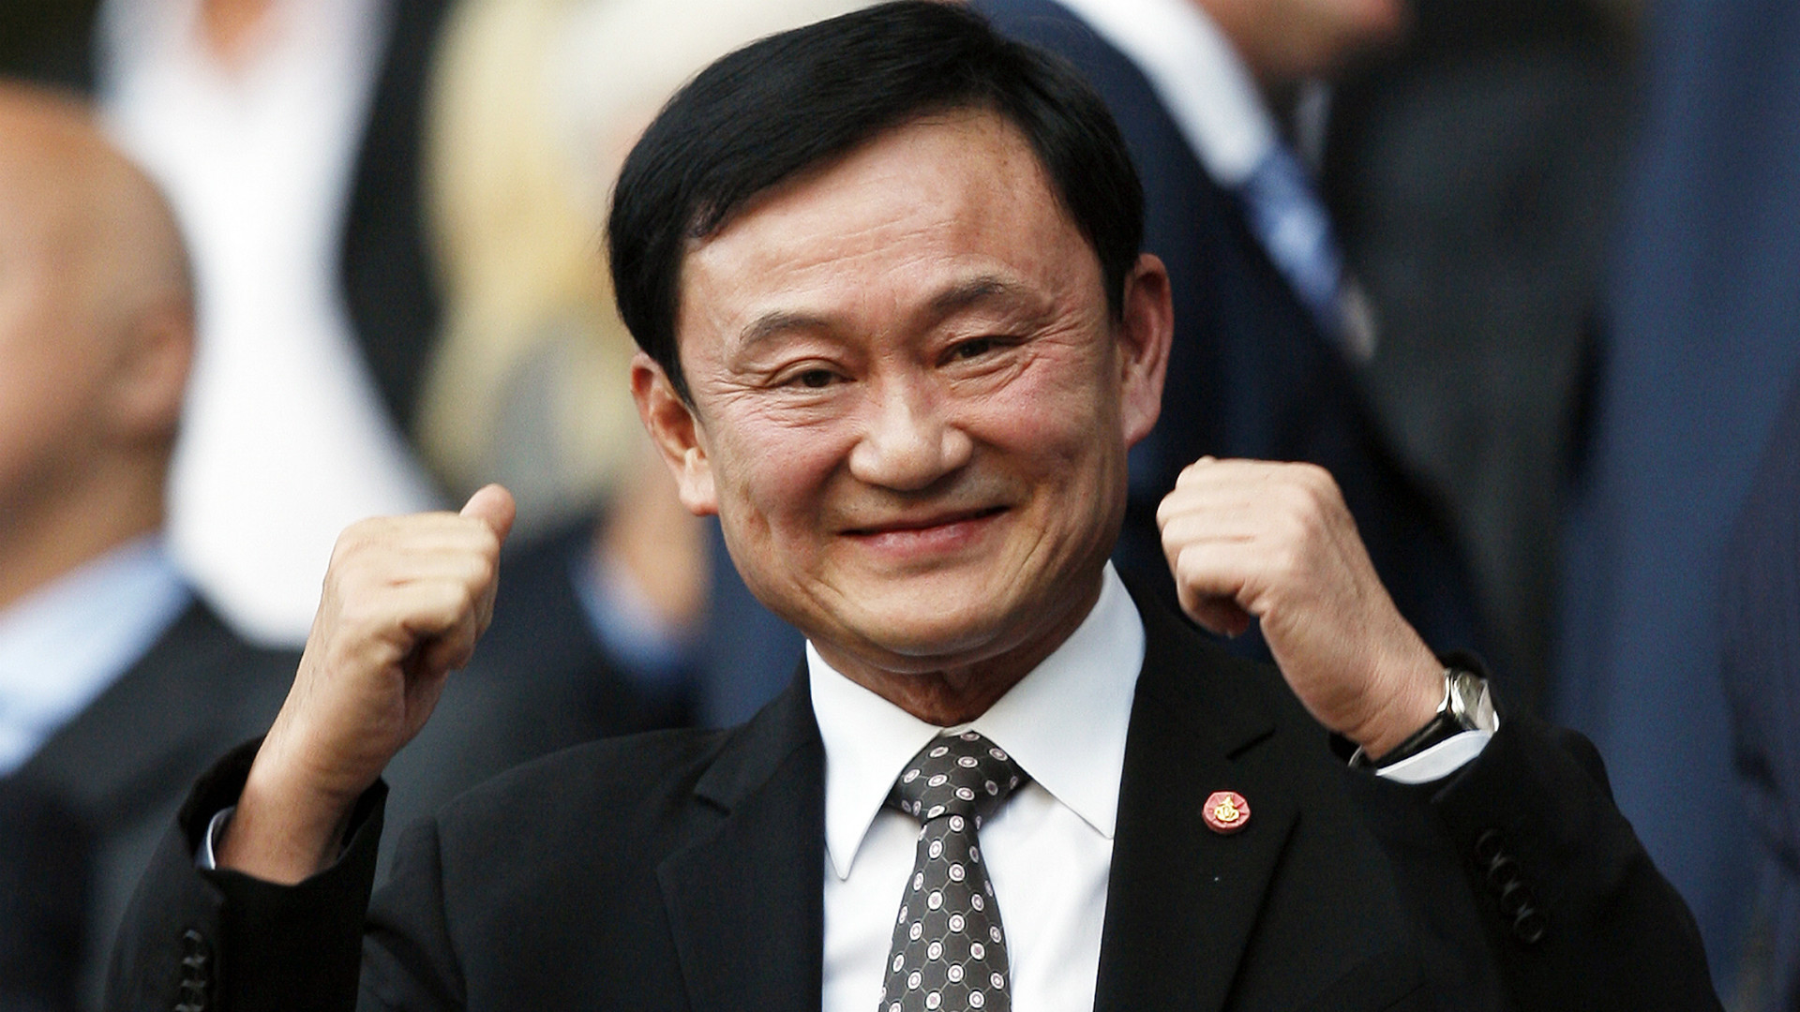
Process Tracing: An Example (Ricks and Liu)
Before 2001, politics in Thailand was a story of weak parties and short-lived governments
In 2001, the Thai Rak Thai (TRT) party led by Thaksin Shinawatra won almost a full majority in parliament and Thaksin became the first prime minister to serve a full term
What accounts for the rise of the TRT?
Two theories
Individual: Wealth and influence of Thaksin
Institutional: 1997 constitution constrained party-switching and forced parties to field candidates for at least 25-50% of seats

Slide 10

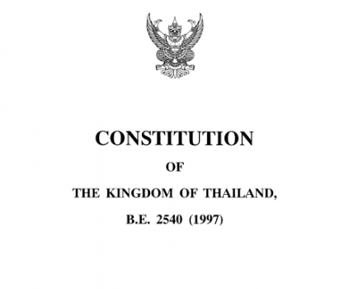
Alternative Choices/Events
Exclusion of the electoral rule changes and institutions by the constitution drafters in 1997
Choice by Thaksin not to create TRT

Slide 11
Counterfactual Outcomes
If the 1997 constitution did not include electoral reforms, there would have been more party-switching (including leaving TRT) and thus more coalition governments
If Thaksin had not set up TRT, small parties still would have shrunk as per Duverger’s Law in the new single member constituencies

Slide 13
Conclusion
Single case studies can be a very powerful tool to investigate causal processes
But we need to be very careful when thinking about
connecting theory and evidence
generalisability
Single cases are not studied in a vacuum

